Slide 1

Data Structures Lecture 6 & 7: Multi-Dimensional Array
By
Ravi Kant Sahu
Asst. Professor
Lovely Professional University, Punjab

Slide 2
Outlines
Introduction
Two-Dimensional Arrays
Memory Representation of Two-Dimensional Arrays
Multidimensional Array
Review Questions

Slide 3
Introduction
Arrays where elements are referenced, respectively, by two or more subscripts.
Some programming languages allow up to 7 dimensional arrays.
Normally we have Two-Dimensional and Three-Dimensional Arrays.

Slide 4
Two-Dimensional Array
A two-dimensional m×n array A is a collection of m*n data elements such that each element is specified by a pair of integers ( e.g. j, k), called subscripts, with the property that
1 <= j <= m
and 1 <= k <= n
The element of A with first subscript j and second subscript k will be denoted by A_{j,k} or A[j, k].
Two-dimensional arrays are called Matrices in mathematics and Tables in business applications.
Two-dimensional arrays are some times known as Matrix Arrays.

Slide 5
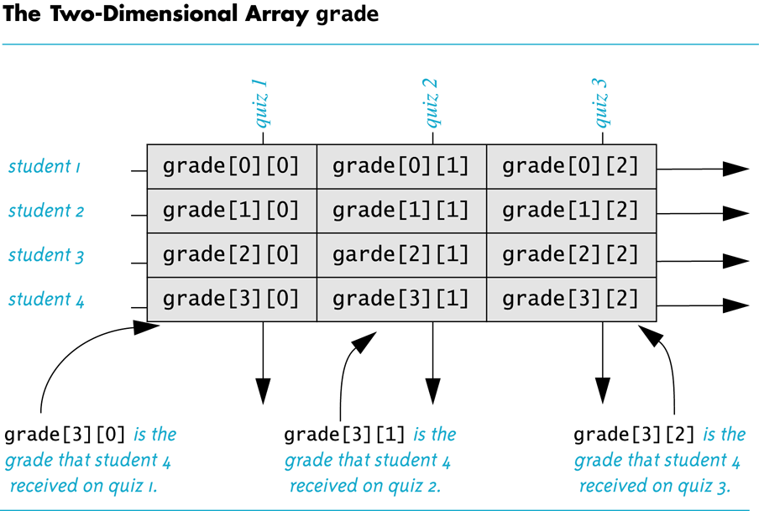

Slide 6
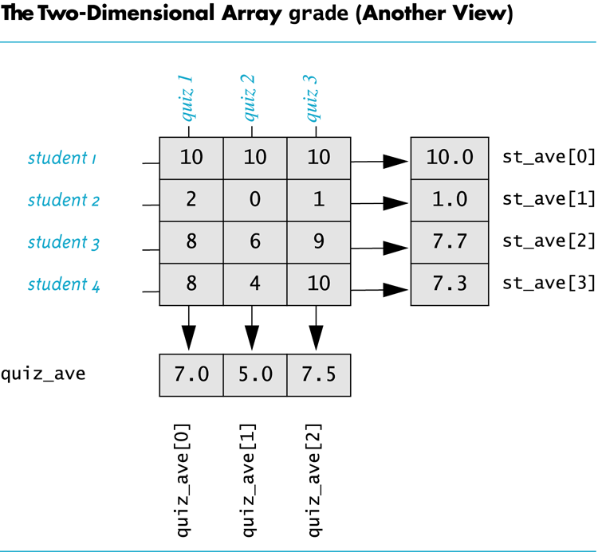

Slide 7
Memory Representation
A Two-Dimensional array will be represented in memory by a block of m*n sequential memory locations.
Two-Dimensional array is stored in the memory is following two orders:
Column-major Order: Column by column.
Row-major Order: Row by row.

Slide 8
Column-Major Order
(1, 1)
(2, 1)
(3, 1)
(1, 2)
(2, 2)
(3, 2)
(1, 3)
(2, 3)
(3, 3)
(1, 4)
(2, 4)
(3, 4)
Column 1
Column 2
Column 3
Column 4

Slide 9
Row-Major Order
(1, 1)
(1, 2)
(1, 3)
(1, 4)
(2, 1)
(2, 2)
(2, 3)
(2, 4)
(3, 1)
(3, 2)
(3, 3)
(3, 4)
Row 1
Row 2
Row 3

Slide 10
Column-Major Order:
LOC (A[j, k]) = Base (A) + w [M (k-1) + (j-1)]
Row-Major Order:
LOC (A[j, k]) = Base (A) + w [N (j-1) + (k-1)]

Slide 11
General Multidimensional Array
An n-dimensional m₁×m₂×...×m_{n} array is a collection of m₁.m₂....m_{n} data elements in which each element is specified by a list of n integers (such as k₁, k₂, k₃...k_{n}) called subscripts, with the property that:
1<= k₁ <= m₁, 1<= k₂ <= m₂, ... 1<= k_{n} <= m_{n}

Slide 12


Slide 13
Review Questions
Given, in a 2-D Array the lower bound and upper bound for first index is 3 and 11 and that for second index is 5 and 9. Find out the size of the array.
In any 2-D Array, which are the elements that will be always having the same memory address for both column-major order & Row-major order?
Consider a 20×5 matrix array Marks. Suppose Base (Marks) = 1002 and words per memory cell w=4. Using Column-major order and row-major order, find out the marks of 3rd and 5th test of student 11.

